Slide 1
Visualization and analysis of Digital Light-sheet microscopy
Luke Peeler
The University of Chicago
7 August 2014
Notes:
Welcome

Slide 2
Roadmap
Introduction
Motivation
Methods
Results
Future Work

Slide 3
Background
Introduction
Understanding cell behavior at various stages of development is a chief goal of developmental biology
Data from various microscopy modalities creates demand for image analysis and visualization tools
Notes:
--Most basic motivation is that dev bios want to understand cell behavior throughout stages of development
--New microscopy modalities, such as the one that we leveraged for this project, give researchers new opportunities, but also a need to new visualization and analysis tools

Slide 4
Background
Introduction
Understanding cell behavior at various stages of development is a chief goal of developmental biology
Data from various microscopy modalities creates demand for image analysis and visualization tools
Common methods, such as maximum-intensity projections are not sufficient
Notes:
--For example, maximum intensity projections are a method favored by biologists, but they may not capture features of the image data that are of research value
--If what we care about are 3D configurations and motion, we can do these visualizations. We discovered an possible anomaly in some of our acquired data, but this likely would have been lost by simply doing a maximum intensity projection. It’s critical to have a variety of tools to not only pursue biological research aims, but to learn about the nature and quality of the data itself.

Slide 5
Questions and Methods
Introduction
Where do cells come from? What path do they take?
Notes:
We have two main questions:
---First, how can we tell where cells originate and what path they take during early embryonic development?

Slide 6
Questions and Methods
Introduction
Where do cells come from? What path do they take?
Particle tracking methods to provide qualitative and quantitative information
Notes:
---One way of addressing that is to implement particle tracking methods to gain quantitative data for further analysis and to produce qualitatively insightful visualizations

Slide 7
Questions and Methods
Introduction
Where do cells come from? What path do they take?
Particle tracking methods to provide qualitative and quantitative information
What is the cellular context for migratory pathways? What might influence movement?
Notes:
--Secondly, what can we learn about the broader context in which cells are moving? Are there interactions with the environment that determine the path they’ll take?

Slide 8
Questions and Methods
Introduction
Where do cells come from? What path do they take?
Particle tracking methods to provide qualitative and quantitative information
What is the cellular context for migratory pathways? What might influence movement?
3D volume rendering techniques to give qualitative perspective within context of overall organismal development
Notes:
---We seek to address this using 3D volume renderings to provide a sense of context against which quantitative results, such as those from particle tracking methods, may be assessed.

Slide 9
Roadmap
Introduction
Motivation
Methods
Results
Future Work
Notes:
More particular motivations for this project

Slide 10
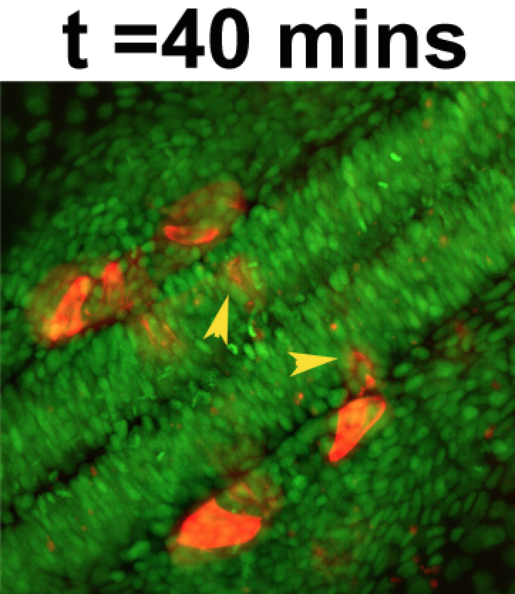
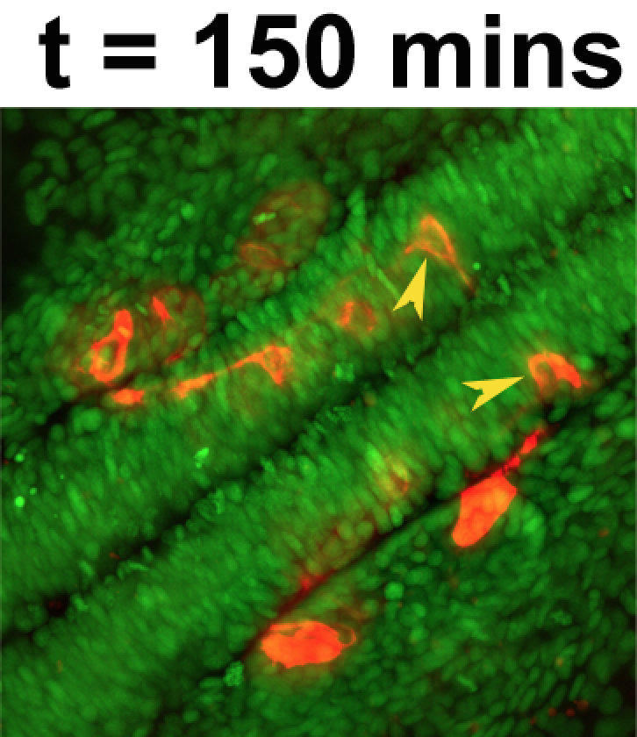
Digital light-sheet microscopy
Motivation
New modality: illuminates specimen slice-by-slice
Minimizes photo-bleaching, photo-toxicity
3D+t datasets at subcellular resolution
Two channels: watch development from two perspectives
But datasets are large…
2000 x 2000 x 300, with two channels at 16 bits per channel and perhaps 100s of time steps
TBs of images acquired
Images courtesy V Prince
Notes:
--DLSM illuminates only the part of the specimen that’s in the focus of the detection system
--This helps to greatly reduce effects of photo-toxicity and photo-bleaching that are of concern when performing in vivo imaging
--Researchers are provided with quality 3D+t data sets with high resolution. In our case, we had access to 3D+t data in two channels
----The green channel label cell nuclei in green, while the red channel labels FBMNs in red
--All of this data is a double-edged sword, however:
----downside---high res images 2000x2000x300 on big side, with 2 channels and 100s of time slices—one slice every few minutes, so TBs of images per day—that’s a challenge– so interesting CS problem

Slide 11
Software for researchers
Motivation
Existing tools may be limited and cause performance bottlenecks
Results serve as proof-of-concept of Diderot, a new parallel domain-specific language (PDSL) designed for image analysis and visualization
Open-source availability of command-line image reader for CZI file format
Notes:
--Another goal in addition to analysis and visualization is to enable researchers with effective tools to take advantage of this great amount of data
--Some currently popular tools, such as ImageJ, are meant to be multipurpose and may not have all of the functionality desired for particular types of analysis and visualization. They may also be sources of performance bottlencks
--Our results with demonstrate the effectiveness of Diderot, a new parallel domain-specific language developed chiefly by members of our CS department
--Additionally, we hope to make available an open-source version of a command-line file reader of the CZI format in which the image data is initially written, with the hope that it may be extended to support conversions to multiple file formats

Slide 12
Analysis of embryonic development
Motivation
Early neurological development depends on cellular migration
Zebrafish embryos: clear membranes, and relatively few neurons
Focus on tangential migration of facial branchiomotor neurons (FBMNs) in zebrafish
Recent discovery and interest in motion of “pioneer” FBMNs
Visualization and analysis of early neurological development
Two questions to answer, two methods to address them
Tracking path of pioneer FBMNs and volume renderings at various time steps
Notes:
--We are focusing primarily on early neurological development in zebrafish embryos, which are considered ideal organisms due to their size, optically clear membranes, and relatively few neurons (~100,000)
--Neurological development depends on cell migration, and we’re focusing in particular on the migratory pathways of so-called pioneer facial branchiomotor neurons (FBMNs), which were recently discovered to emerge first from the zebrafish hindbrain in order to migrate
--We have two questions about this migration process to try to answer, and two methods by which to attempt to do so
(where neurons are going in space? And how to get useful anatomical context?)

Slide 13
Roadmap
Introduction
Motivation
Methods
Results
Future Work

Slide 14
Particle tracking
Methods
Essential aim to recover motion of particles between adjacent frames of image data
Algorithms include cross-correlation methods, deterministic methods, and Bayesian methods
Notes:
--Put simply, particle tracking aims to determine the motion of particles through time, often using adjacent time steps for analysis
--There are various methods, including cross-correlation, deterministic methods, and Bayesian methods
Other deterministic methods suggest separating segmentation and tracking steps. Goal is to minimize cost function
Bayesian methods are concerned with state-space and modeling objects using state vectors, making predictions and updating the predictive model
Why xcorr?
A: we wanted to evaluate the simplest thing first to see how much more effort is needed on the tracking—that’s the scope of the work

Slide 15
Cross-Correlation method
Methods
Also known as “sliding dot-product”
Evaluate frame at time t+1 using estimated position of particle at time t, “sliding” template image around target image
Cross-correlation value is highest when particles overlap most, giving displacement of particle between frames t and t+1
Notes:
--Cross-correlation functions by analyzing adjacent time points by using a template particle and moving it around in space, computing a dot product between the target image and template at each position, and then determining where the dot product was maximized, using the estimated position of the frame at time “t” as a starting point

Slide 16
Theoretical basis
Methods
represents image of N ideal particles:
We wish to minimize
We can expand:
Simplified:
If
Notes:
--Here’s the theoretical basis for the computation
--The essential goal is to minimize chi-squared, the least-squares fit function. For simplicity, we ignore the weight function W, but it may be used to factor in how sharply particles are defined in the data.

Slide 17
Theoretical basis
Methods
represents image of N ideal particles:
We wish to minimize
We can expand:
Simplified:
If
Notes:
--To minimize chi-squared, we seek to maximize the value of the image “I” convolved with the template image “Ip”, which ideally is maximum when the template particle aligns most with the position of the particle in the next frame

Slide 18
Discrete computation of
Methods
Notes:
--Here are the details of how the computation is performed on our discrete data
--The numerator represents the dot product at given offsets, ox, oy, and oz, and the denominator serves to normalize the values based on the intensity of the image data in I and Ip at those points

Slide 19
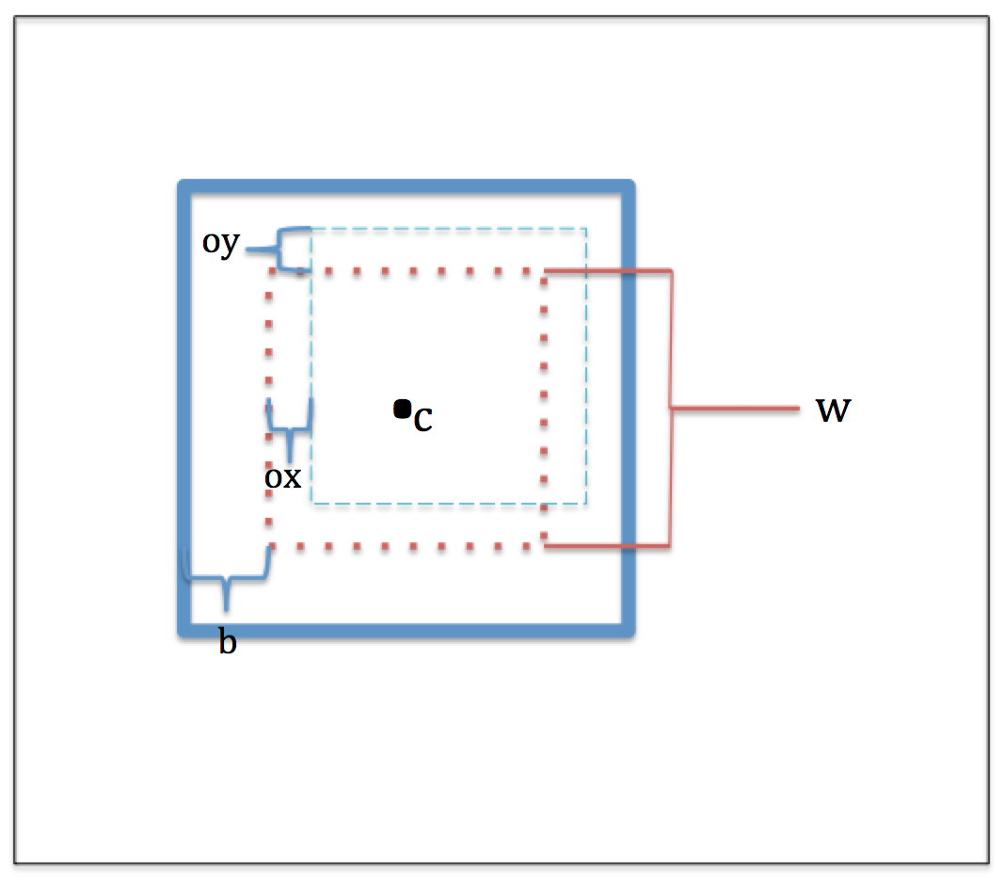
Practical adjustments
Methods
Let be represented by a region of size w, around cell center, c, in frame t
Focusing on one cell, restrict computation to small area of target image in frame t+1 related to cell diameter, w, and maximum displacement, b
Notes:
--We make a few departures from the theoretical foundation for the sake of practicality—Ip is not modeled, but taken to be a region of from frame t containing the cell. This is then used as the ideal particle which is computed with the image data in frame t+1 within sound bound, b, along each axis

Slide 20
Methods
crossCorrImg:
max_value = 0
max_x = max_y = max_z = -1
for –b <= oz <= b:
for –b <= oy <= b:
for –b <= ox <= b:
value = crossCorr(oz, oy, ox, img_{T}, img_{T+1}, w, c)
if value > max_value:
max_value = value
max_x = ox
max_y = oy
max_z = oz
Notes:
--This code represents the “sliding” of the template region around frame t+1, with offsets from the previous frame’s center dictated by ox, oy, and oz
--The cross correlation value is computed by the crossCorr routine (up next) and the maximum and argmax are updated if needed

Slide 21
Methods
crossCorr:
lo_z = c_{z} – w/2, hi_z = lo_z + w
lo_y = c_{y} – w/2, hi_y = lo_y + w
lo_x = c_{x} – w/2, hi_x = lo_x + w
dot_{c0 =} dot_{c1} = 0
len_{T,c0} = len_{T,c1} = len_{T+1,c0} = len_{T+1,c1} = 0
for lo_z <= z <= hi_z:
for lo_y <= y <= hi_y:
for lo_x <= x <= hi_x:
dot_{c0} += sample(img_{T},x-ox, y-oy, z-oz, channel0) *
sample(img_{T+1},x-ox, y-oy, z-oz, channel0)
dot_{c1} += sample(img_{T},x-ox, y-oy, z-oz, channel1) *
sample(img_{T+1},x-ox, y-oy, z-oz, channel1)
len_{T,c0} += sample(img_{T},x-ox, y-oy, z-oz, channel0)²
len_{T+1,c0} += sample(img_{T+1},x-ox, y-oy, z-oz, channel0)²
len_{T,c1} += sample(img_{T},x-ox, y-oy, z-oz, channel1)²
len_{T+1,c1} += sample(img_{T+1},x-ox, y-oy, z-oz, channel1)²
return dot_{c0} / (sqrt(len_{T,c0})*sqrt(len_{T+1,c0})) +
dot_{c1} / (sqrt(len_{T,c1})*sqrt(len_{T+1,c1}))
Notes:
--This routine essentially performs pixel by pixel computation within the region specified by the value of w, the offset values, and the center point
--In this case, we return a value reflecting cross-correlation between both channels

Slide 22
Volume rendering methods
Methods
Maximum-intensity projections (MIPs) are fast, common visualizations of biological image data
Produces visualizations biologists are accustomed to
Volume rendering methods incorporating opacity, shading, and color maps
More sophisticated, hopefully useful at revealing 3D context of development
Notes:
-Max intensity projections are commonly used by biologists and are an efficient means of generating a visualization that gives some 3D perspective.
-We sought to generate these, but complement them with more complex and computationally-expensive renderings that involve opacity, shading, and compositing computations, and in one case, a color map to visualize spatial relationships
-Our goal was to present a clearer view of the 3D environment in which development is occurring

Slide 23
Maximum-intensity projections
Methods
Projection of highest-intensity voxels intersected by rays traced from the viewpoint to projection plane
Animations may be generated using different viewpoints for 3D effect
Biologists most often use projections along z-axis

Slide 24
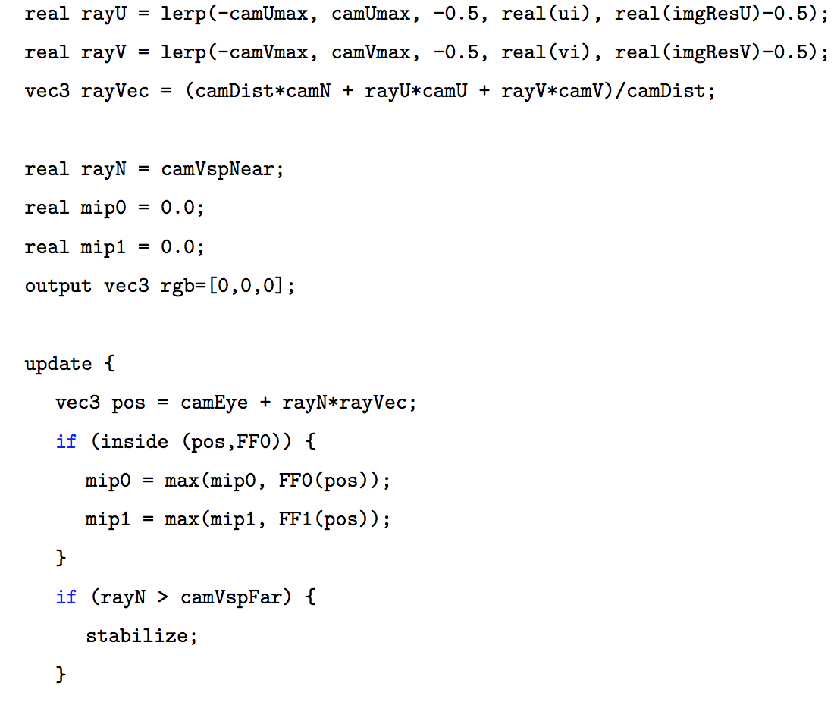
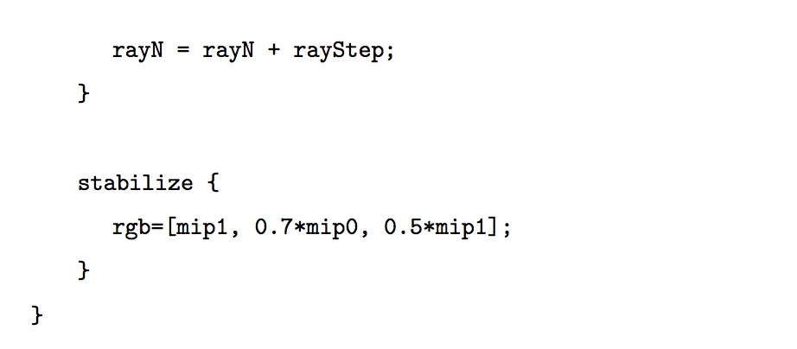
Methods
For each ray in U-V plane
Determine ray direction
mip0 = mip1 = 0
Trace ray, step by step, through viewing space toward projection plane
a) Sample image, get val0 and val1
b) mip0 = max(mip0, val0), mip1 = max(mip1, val1)
c) if ray has been traced past far clipping plane
i) R = mip1, G = mip0
ii) Save pixel to image
iii) Terminate ray

Slide 25
Volume rendering with shading, opacity, compositing, and color maps
Methods
Similar process of ray casting as in MIPs
Opacity and shading of a voxel computed in independent steps
Composited with front-to-back compositing
Opacity of voxels near isovalue scale inversely with magnitude of local gradient vector
Avoids aliasing artifacts
Directional shading (one light)
Distance-encoded rendering: color map to visualize signed distance to approximate cell membrane
Notes:
-We sample volume along rays and compute shading information using negative local gradient as implicit surface normal. Assign opacity using transfer function and composite the them with the over operator to compute a final pixel color.
-Shading is computed using a single directional light
-Our distance-encoded rendering (to be explained soon) uses a colormap to visualize signed distance of nuclei to the approximate cell membrane

Slide 26
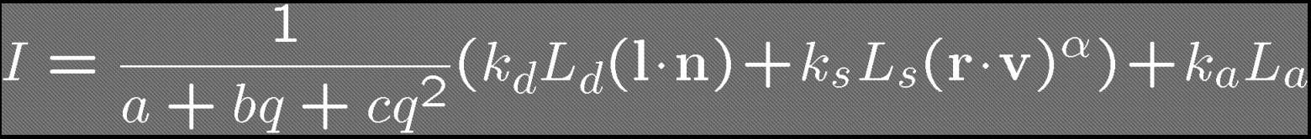
Opacity, shading, and compositing
Methods
Notes:
Light components for each color:
– Ambient (L_a), diffuse (L_d), specular (L_s)
• Material coefficients for each color:
– Ambient (k_a), diffuse (k_d), specular (k_s)
• Distance q for surface point from light source
l = vector from light
n = surface normal
r = l reflected about n
v = vector to viewer
TODO: how was isoval chosen?

Slide 27
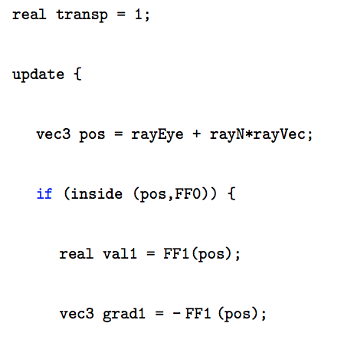
Methods
For each ray in U-V plane
Determine ray direction
transp = 1
Trace ray, step by step, through viewing space
Sample image, get val1
grad1 assigned negative gradient of image at current location
Opacity assigned using val1 and grad1 thru transfer function
Shading computed
RGB color composited
f) if ray has been traced past far clipping plane or transp = 0
ii) Write RGB pixel to file
iii) Terminate for this ray

Slide 28
Methods
For each ray in U-V plane
Determine ray direction
transp = 1
Trace ray, step by step, through viewing space
Sample image, get val1
grad1 assigned negative gradient of image at current location
Opacity assigned using val1 and grad1 thru transfer function
Shading computed
RGB color composited
f) if ray has been traced past far clipping plane or transp = 0
ii) Write RGB pixel to file
iii) Terminate for this ray

Slide 29
Methods
For each ray in U-V plane
Determine ray direction
transp = 1
Trace ray, step by step, through viewing space
Sample image, get val1
grad1 assigned negative gradient of image at current location
Opacity assigned using val1 and grad1 thru transfer function
Shading computed
RGB color composited
f) if ray has been traced past far clipping plane or transp = 0
ii) Write RGB pixel to file
iii) Terminate for this ray

Slide 30
Methods
For each ray in U-V plane
Determine ray direction
transp = 1
Trace ray, step by step, through viewing space
Sample image, get val1
grad1 assigned negative gradient of image at current location
Opacity assigned using val1 and grad1 thru transfer function
Shading computed
RGB color composited
f) if ray has been traced past far clipping plane or transp = 0
ii) Write RGB pixel to file
iii) Terminate for this ray

Slide 31
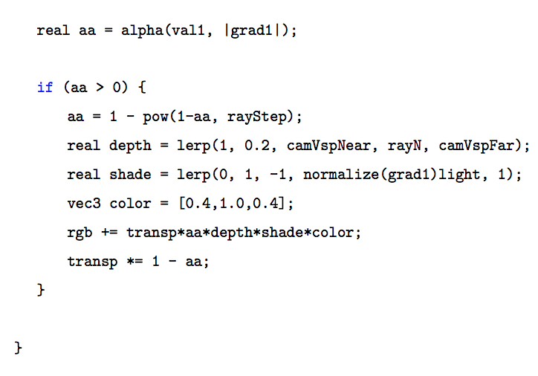
Methods
For each ray in U-V plane
Determine ray direction
transp = 1
Trace ray, step by step, through viewing space
Sample image, get val1
grad1 assigned negative gradient of image at current location
Opacity assigned using val1 and grad1 thru transfer function
Shading computed
RGB color composited
f) if ray has been traced past far clipping plane or transp = 0
ii) Write RGB pixel to file
iii) Terminate for this ray
Notes:
Isoval choice?
You could also try threshold ing the 2d MIP image, which would give you similar guidance.

Slide 32
Methods
For each ray in U-V plane
Determine ray direction
transp = 1
Trace ray, step by step, through viewing space
Sample image, get val1
grad1 assigned negative gradient of image at current location
Opacity assigned using val1 and grad1 thru transfer function
Shading computed
RGB color composited
f) if ray has been traced past far clipping plane or transp = 0
ii) Write RGB pixel to file
iii) Terminate for this ray

Slide 33
Methods
For each ray in U-V plane
Determine ray direction
transp = 1
Trace ray, step by step, through viewing space
Sample image, get val1
grad1 assigned negative gradient of image at current location
Opacity assigned using val1 and grad1 thru transfer function
Shading computed
RGB color composited
f) if ray has been traced past far clipping plane or transp = 0
ii) Write RGB pixel to file
iii) Terminate for this ray
Notes:
-- opacity is modulated here based on step size to make opacity invariant to differences in step size
---- maintains manner in which opaqueness asymptotically increased further inside the volume

Slide 34
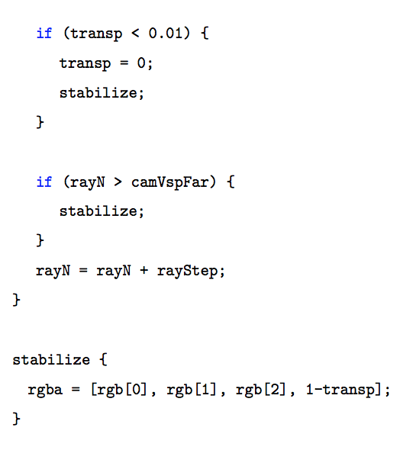
Methods
For each ray in U-V plane
Determine ray direction
transp = 1
Trace ray, step by step, through viewing space
Sample image, get val1
grad1 assigned negative gradient of image at current location
Opacity assigned using val1 and grad1 thru transfer function
Shading computed
RGB color composited
f) if ray has been traced past far clipping plane or transp = 0
ii) Write RGB pixel to file
iii) Terminate for this ray

Slide 35
Methods
For each ray in U-V plane
Determine ray direction
transp = 1
Trace ray, step by step, through viewing space
Sample image, get val1
grad1 assigned negative gradient of image at current location
Opacity assigned using val1 and grad1 thru transfer function
Shading computed
RGB color composited
f) if ray has been traced past far clipping plane or transp = 0
ii) Write RGB pixel to file
iii) Terminate for this ray

Slide 36
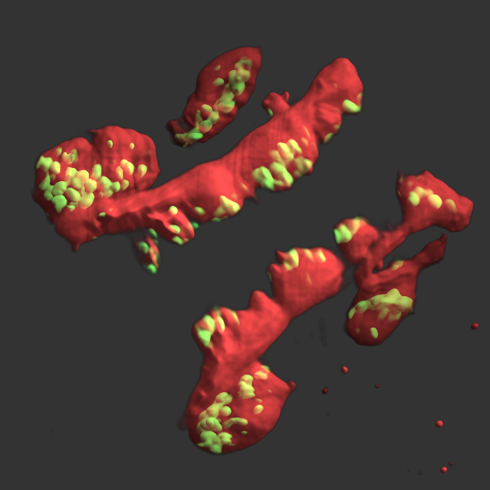
Distance-encoded rendering
Methods
Aim to restrict area rendered and visualize distance between image features
Needed to investigate possible anomaly in regular 2-channel rendering
Notes:
--initially wanted to visualize volume rendering using two channels
--image at right revealed anomaly in location of nuclei relative to neuron membrances; we wanted to address this

Slide 37

Distance transform and color mapping
Methods
Performed using distance transform on red-channel volume to generate distance map
Volume rendering performed as described previously, but with both channels
Color assigned to green-channel image data modulated by distance to neuron membrane
Position indexes into distance map, whose value indexes to a color map to visualize distance
+30μm
0
-30μm
Notes:
-- generate map to link positions inside isosurface approximating cell membrane to their distance to the membrane
-- perform same volume rendering as before, but use both channels, with red channel appearing translucent and the green channel being assigned RGB values based on distance to the cell membrane, using the colormap at right

Slide 38
Roadmap
Introduction
Motivation
Methods
Results
Future Work

Slide 39
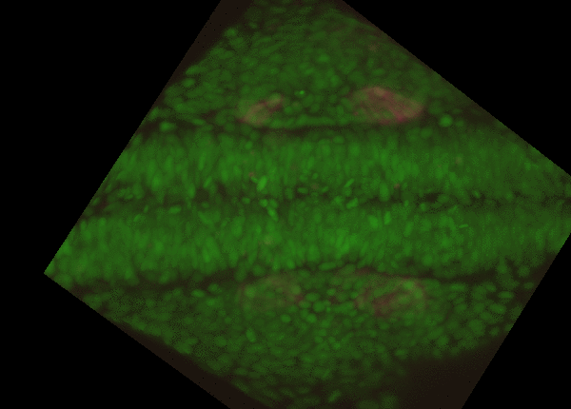

MIP rendering results
Results
Notes:
--basic 2 channel MIP animation to give a sense of the data and how the neurons move through time

Slide 40
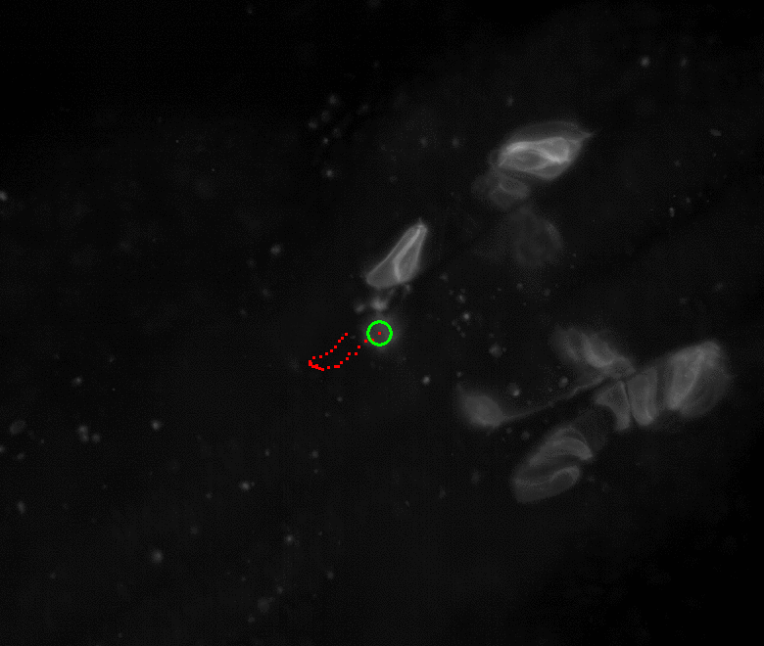

Cross-correlation results
Results
Motion in x-y plane
Notes:
--motion in the xy plane showing projected path of pioneer neuron
--it seems the shape of the path is correct, but that it lags behind after a certain point
--perhaps due to increasing presence of fluorescent proteins later in development and the approach of other FBMNs
--we’re tracking a membrane, not a cell center and the cell is changing shape, so that affects results greatly

Slide 41
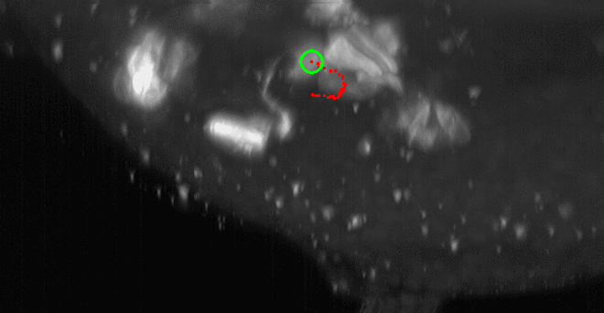

Cross-correlation results
Results
Motion in y-z plane
Notes:
-view from the y-z plane
--one issue is that using a single seed value for the center of the neuron in the first frame will cause error values to propagate and compound in successive computations

Slide 42
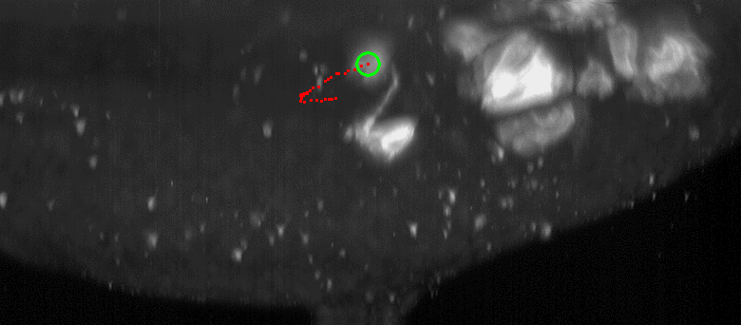

Cross-correlation results
Results
Motion in x-z plane
Notes:
--view from the x-z plane—seems to be most accurate
--ideally we could eventually create a volume rendering to visualize the path and cell motion in all three spatial dimensions

Slide 43
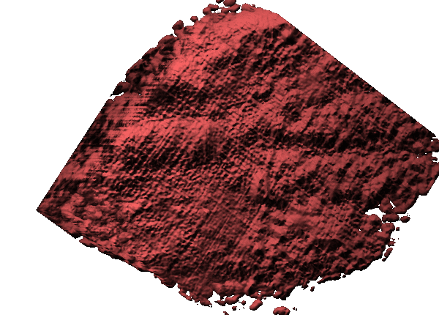
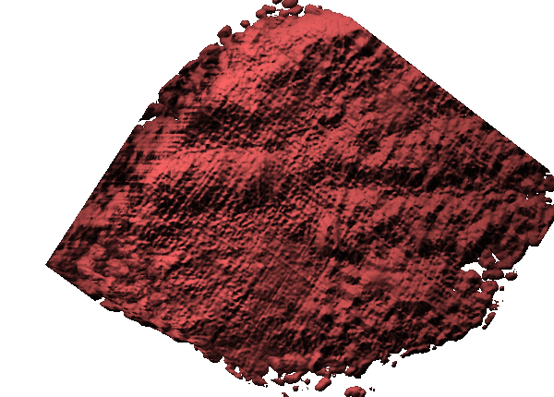
Ray casting rendering results
Results
Isoval = 1000

Slide 44
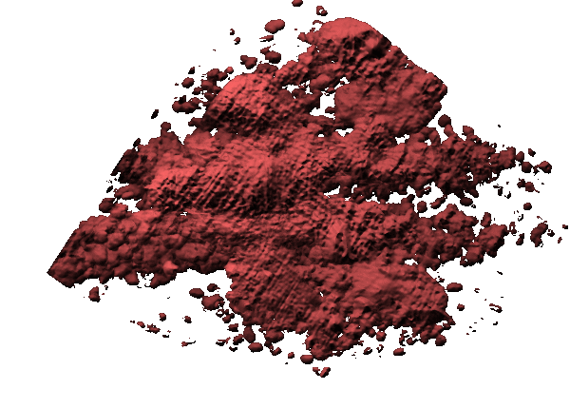
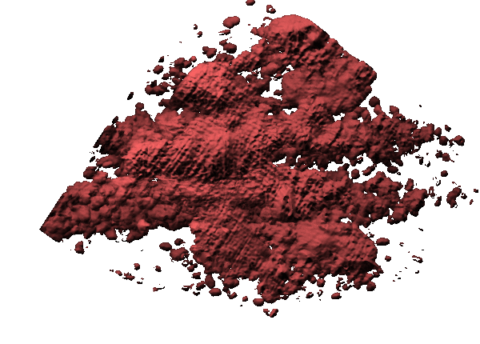
Ray casting rendering results
Results
Isoval = 1100

Slide 45
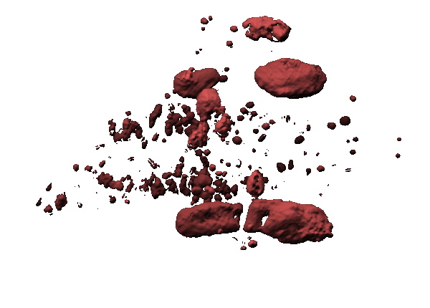
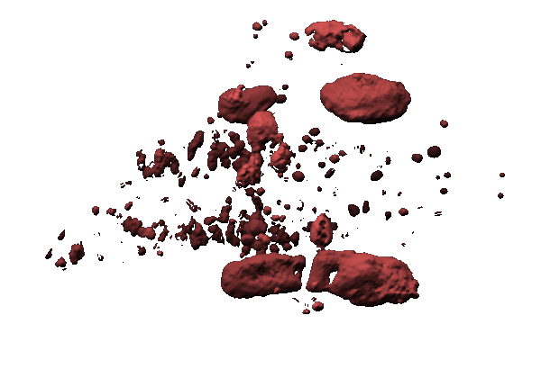
Ray casting rendering results
Results
Isoval = 1200

Slide 46
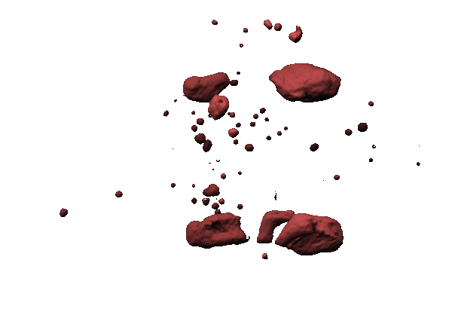
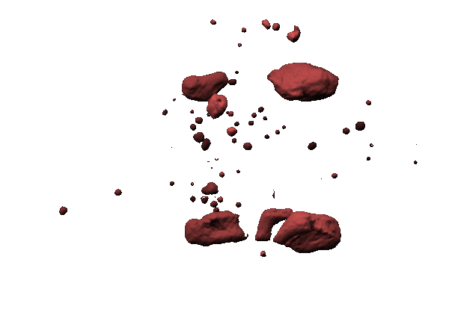
Ray casting rendering results
Results
Isoval = 1300

Slide 47
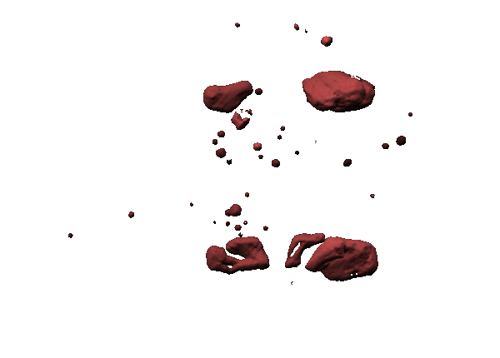
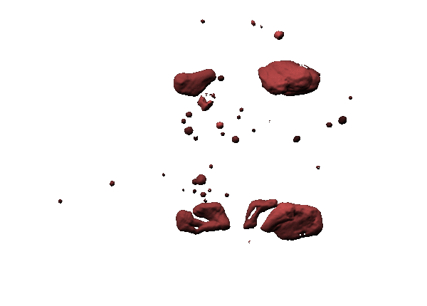
Ray casting rendering results
Results
Isoval = 1400

Slide 48
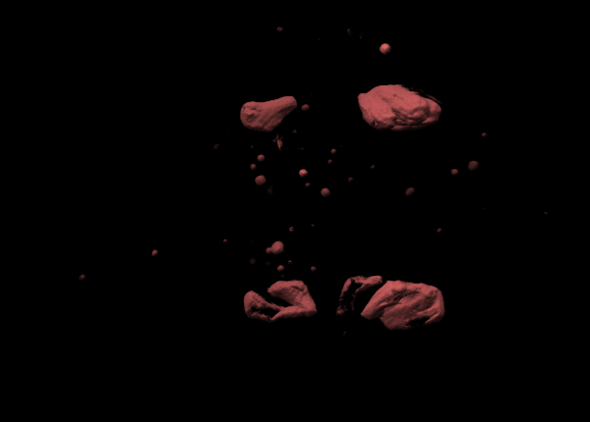

Ray casting rendering results
Results
Isoval = 1500
Notes:
--volume rendering at chose isovalue and seems to best approximate the neurons’ cell membranes

Slide 49
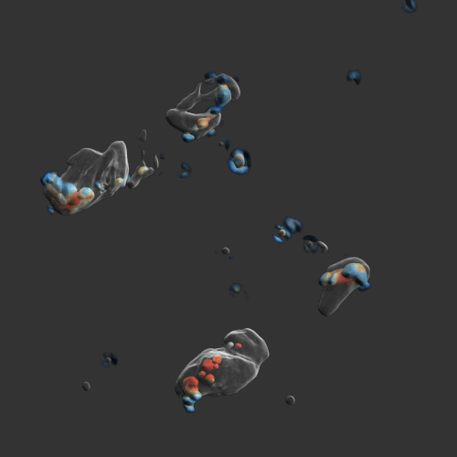

Distance-encoded rendering results
Results
+30μm
0
-30μm
Notes:
This shows how it defies our expectations…
Red flag for how much we should trust info in general
Use visualization to expose ourselves to possibilities that things won’t be what we expect
Want to verify research hypotheses but need to be open to the idea that data may be bad—or the data defies some assumptions we have

Slide 50
Roadmap
Introduction
Motivation
Methods
Results
Future Work

Slide 51
Future Work
Future Work
More image data, perhaps adjusted acquisition parameters
Preprocessing of data to de-noise and more accurately identify cell center at initial frame
Correct for increase in brightness due to more fluorescent proteins at later frames
Crop frame t before each computation to improve cache locality
Packaging scripts and source code into utility directly usable by researchers

Slide 52
Acknowledgments
Dr. Gordon Kindlmann, Advisor
Dr. Yali Amit and Dr. Victoria Prince, Committee
Dept. of Computer Science, The University of Chicago
Scott McDonald, Carl Zeiss Microscopy
Microscopy Core Facility, The University of Chicago
Dr. Christine Labno, Dr. Vytas Bindokas, Dr. Sarah Wanner
Members of the Diderot Project
Charisee Chiw, Lamont Samuels, Nicholas Seltzer, Dr. John Reppy, Dr. Gordon Kindlmann

Slide 53
Questions?

